Slide 1

Truck Platooning
Furkan Ali Yurdakul – 7215046
Bruno Hyska – 7216772
Ian Murnane – 7216662
Elbek Bakiev – 7216249

Slide 2
Content
Problem domain
Requirements
Communication
Architecture
Control Behaviour
Implementation

Slide 3


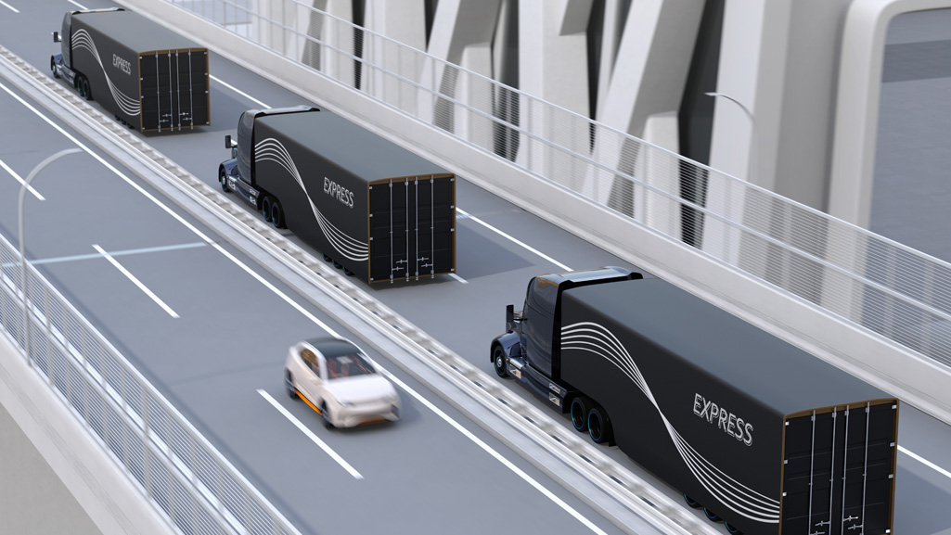
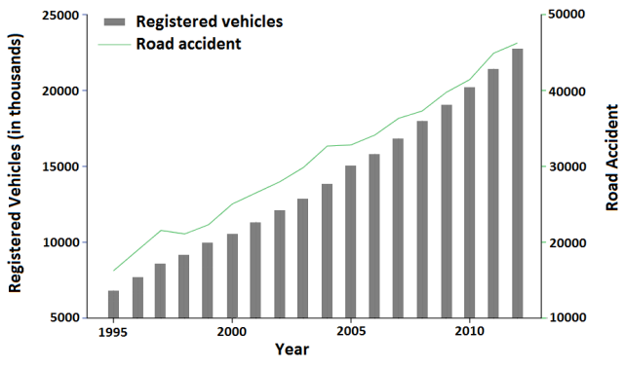
Problem Domain
In a world of :
Unstable and high oil prices
Air pollution at its highest level
Increase in number of vehicles leading to increase in number of accidents
The answer is easy: Truck Platooning

Slide 4
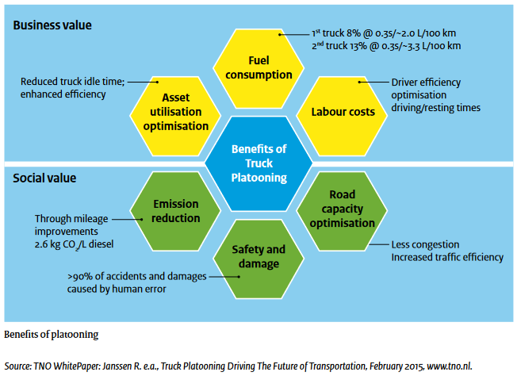
Problem Domain

Slide 5
Requirements
Label | Priority | Description
Development
FR-D-1 | MUST | Architecture must be concurrent, distributed and parallel
FR-D-2 | SHOULD | Developed using Pure functional behavior
FR-D-3 | COULD | Threading handled by OpenMP
Prerequisites
FR-P-1 | MUST | All trucks have a driver
FR-P-2 | COULD | Network layer is abstracted for simplification and demonstration
FR-P-3 | SHOULD | The system environment is a simplified ideal-world for demonstration purposes. This includes: No other vehicles on the test track Simple road system with 90° intersections No traffic control, signs or speed limits
High Level
FR-H-1 | MUST | Trucks can form a platoon. A platoon is defined as 2 or more vehicles consisting of a leader and followers (members)
FR-H-2 | MUST | A truck in a platoon will autonomously follow a member vehicle at a specified distance. This incorporates autonomous steering and autonomous acceleration and braking.
Label | Priority | Description
Membership
FR-M-1 | MUST | Trucks can request to join platoon
FR-M-2 | SHOULD | Join requests must be able to be accepted or rejected
FR-M-3 | SHOULD | Platoon data will only be shared with members
FR-M-4 | COULD | Membership can be revoked by the member
FR-M-5 | MUST | The leader is the vehicle at the front
FR-M-6 | MUST | Trucks can only join at the end of the queue
Communication
FR-C-1 | MUST | Followers must publish a regular heartbeat message at a specified interval
FR-C-2 | MUST | All vehicles should publish their state including when they brake
Shared Data
FR-S-1 | MUST | Members list, specifying leader
FR-S-2 | COULD | Destination
FR-S-3 | COULD | Route (not implemented in demo system)
FS-S-4 | MUST | Data is encoded into a message format
Fault Handling
FR-F-1 | SHOULD | Members will be removed when communication has timed-out
FR-F-2 | SHOULD | Vehicles can couple and de-couple as required

Slide 6

Communication
The lightweight and efficient messaging protocol
Low Overhead: Reduces network congestion
Reliability: Publish-subscribe messaging pattern
Scalability: Can handle a large number of connected devices
Security: Built-in security - encryption and authentication
Notes:
MQTT (Message Queuing Telemetry Transport) protocol is a lightweight and efficient messaging protocol that is designed for constrained devices and unreliable network connections. It is widely used in the Internet of Things (IoT) and Machine-to-Machine (M2M) communication systems. MQTT is well-suited for truck communication in truck platooning due to the following reasons:
Low Overhead: MQTT is a lightweight protocol that has a low network overhead, which makes it ideal for communication between trucks in a platoon. The protocol is designed to minimize the amount of data that needs to be transmitted, reducing network congestion and conserving battery power.
Reliability: MQTT uses a publish-subscribe messaging pattern that ensures that messages are reliably delivered to their intended recipients. This makes it suitable for truck platooning, where reliable and timely communication between trucks is critical to ensure safe and efficient platooning.
Scalability: MQTT is a scalable protocol that can handle a large number of connected devices. This is important in truck platooning, where multiple trucks need to be connected and communicating with each other in real-time.
Security: MQTT provides built-in security features, including encryption and authentication, to ensure that data is transmitted securely. This is important in truck platooning, where sensitive data is being transmitted between trucks.

Slide 7



Communication
Messaging library that provides high-performance messaging patterns for distributed systems
Fully managed service provided by Amazon Web Services that enables secure and scalable communication between Internet of Things (IoT) devices and the cloud
Message broker that uses the MQTT protocol, designed specifically for machine-to-machine communication

Slide 8
Communication
Cloud-based platform
Scalability: Easily handles the large number of devices required for truck platooning
Security: Protects data and devices from unauthorized access, making it a more secure solution than ZeroMQ and HiveMQ
Analytics: Critical for truck platooning - real-time data analysis and visualization; allows to monitor of vehicle performance and identify potential issues in real-time

Slide 9
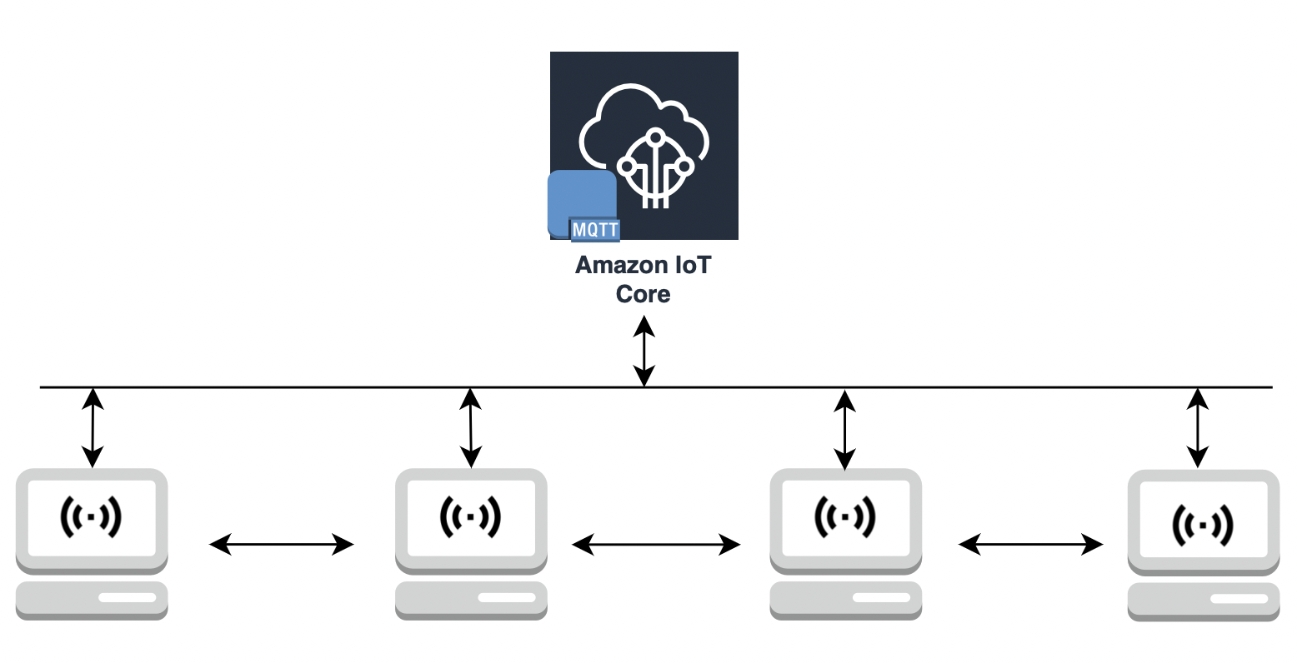
Architecture
Distributed Architecture
Different computing resources spread across a network working work together to perform a specific function
Resources communicating through AWS IoT Core

Slide 10
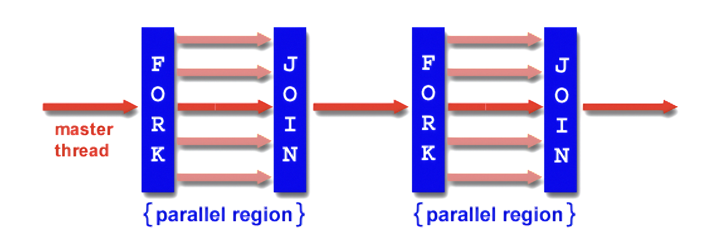
Architecture
Parallel Architecture
Multiple computing resources work together to execute a program or a task in parallel
Parralelism is provided by OpenMP

Slide 11
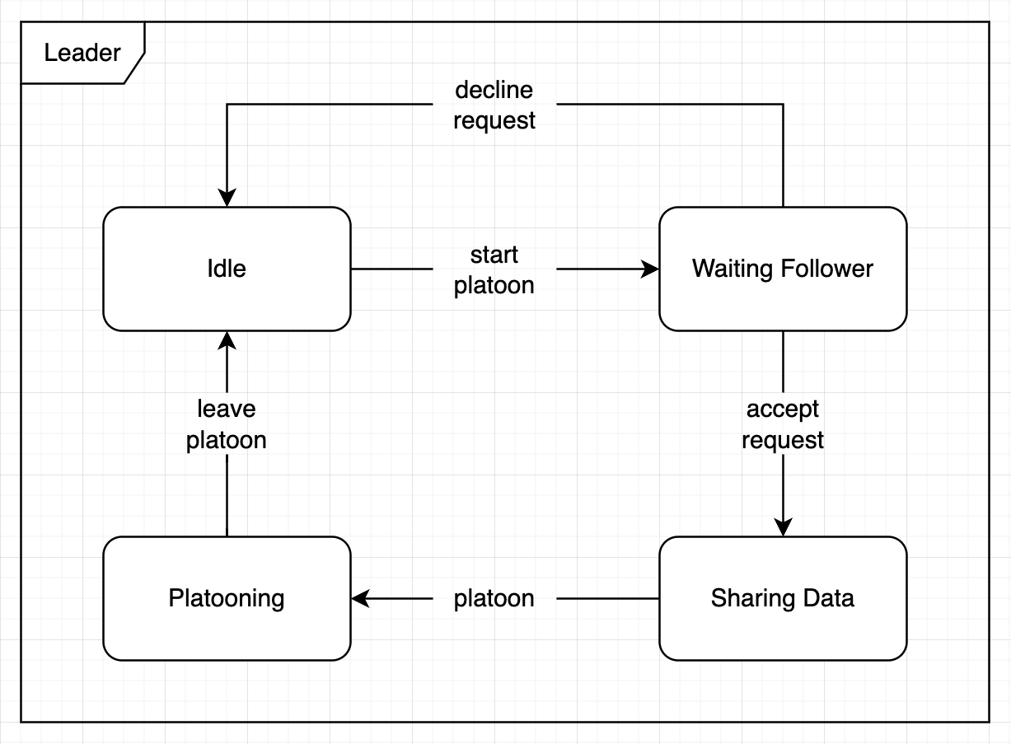
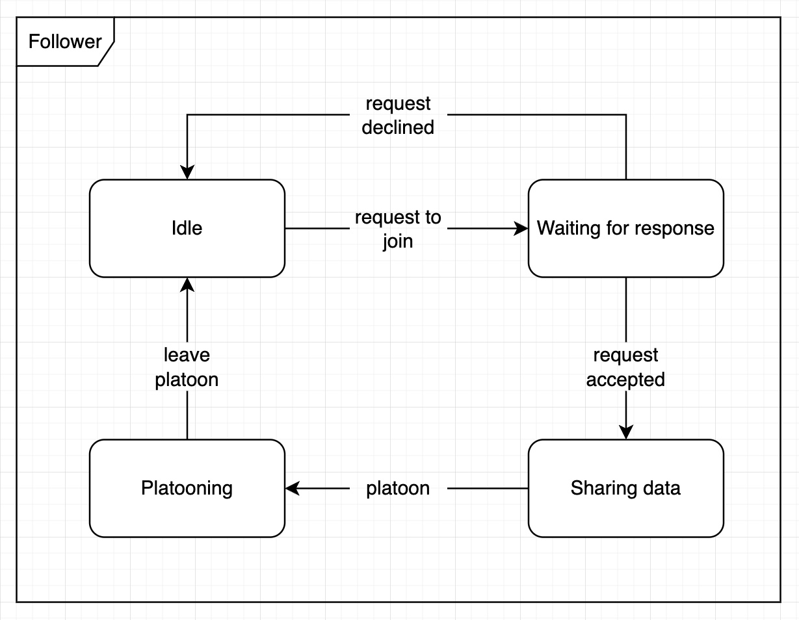
Control Behaviour
State Machine Diagram
Leader Truck State Machine Diagram
Follower Truck State Machine Diagram

Slide 12
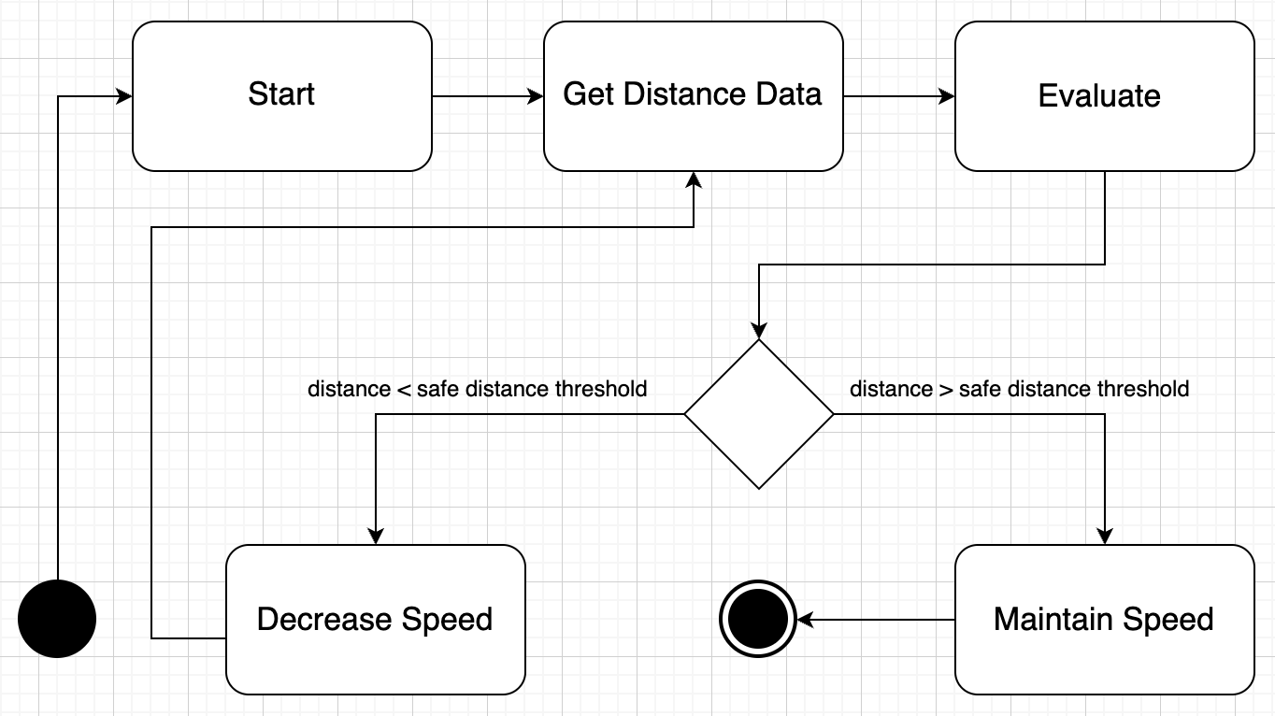
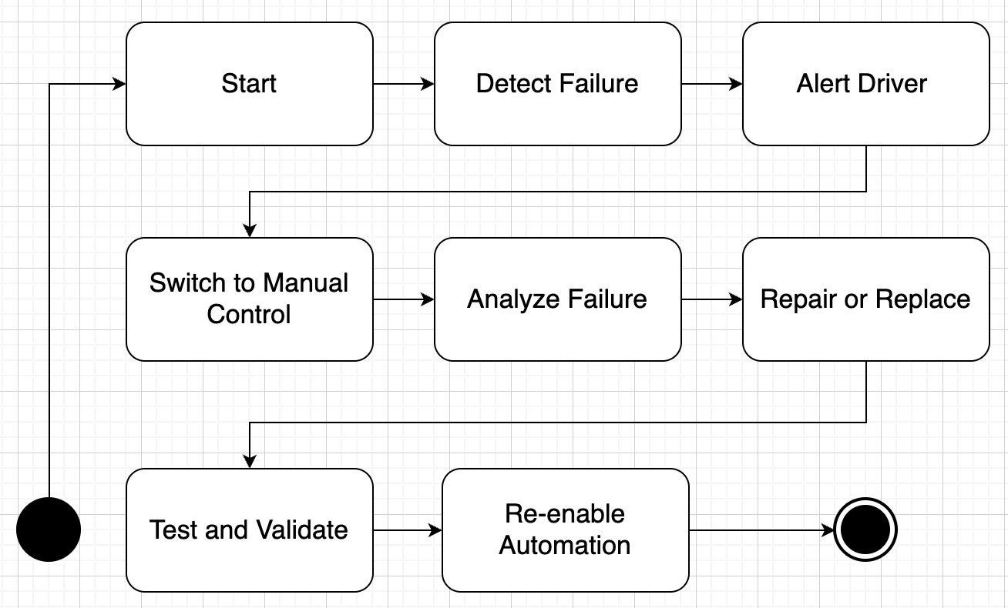
Control Behaviour
Activity Diagrams
How the distance is controlled by trucks
System behavior in cases of failure

Slide 13
OpenMP Implementation
VehicleControl::VehicleControl(Document &vehicleModel, ThreadSafeQueue &threadSafeQueue) {
. . . while (true) { #pragma omp critical { // get the position position = make_pair(vehicleModel["x"].GetDouble(), vehicleModel["y"].GetDouble()); // update the position and direction direction = changeDirectionAtBoundary(position, direction); position = move(position, direction); // write to the vehicleModel vehicleModel["x"].SetDouble(position.first); ... // add direction double angle = atan2(direction.second, direction.first) * 180 / M_PI; if (angle < 0) angle += 360; } // tell the AWS section to publish the vehicleModel threadSafeQueue.push("update"); this_thread::sleep_for(chrono::milliseconds(INTERVAL_TIME_MS)); } }

Slide 14
OpenMP Implementation
Communication::Communication(ThreadSafeQueue threadSafeQueue, std::shared_ptr<Mqtt::MqttConnection> connection, String clientId, String topic) { _connection = connection; _topic = (&topic)->c_str(); auto onConnectionCompleted = [&](Mqtt::MqttConnection &, int errorCode, Mqtt::ReturnCode returnCode, bool) { if (errorCode) { fprintf(stdout, "Connection failed with error %s\n", ErrorDebugString(errorCode)); connectionCompletedPromise.set_value(false); } else { #pragma omp critical fprintf(stdout, "Connection completed with return code %d\n", returnCode); connectionCompletedPromise.set_value(true); } };
. . .
}

Slide 15
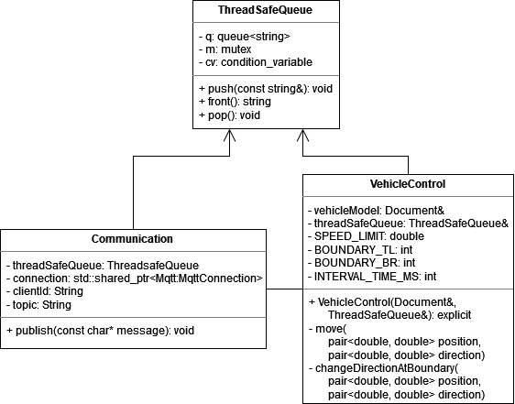
Implementation (Class diagram)
Class diagram of the main code (C++)
VehicleControl - vehicle model and control system and is responsible for performing the necessary calculations and logic to move the vehicle
Communication - handles the MQTT communication protocol and sends messages to a remote server
ThreadSafeQueue - that provides a thread-safe implementation of a queue data structure

Slide 16
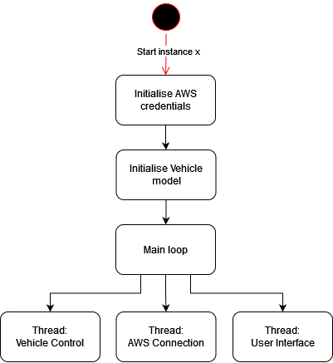
Implementation (Activity Diagram)
Activity diagram of the main code (C++)
Starts by creating an instance
Initializes the necessary AWS credentials and the vehicle model
In the main loop it creates three threads to handle the Vehicle Control, AWS Connection, and User Interface tasks

Slide 17
Implementation (Python)
The code which below represents creating a canvas:
from tkinter import * WIDTH = 980 HEIGHT = 800
win = Tk() win.title("Truck Canvas") win.geometry("%sx%s" % (WIDTH, HEIGHT)) canvas = Canvas(win, width=WIDTH,
height=HEIGHT, background="white")
Establish a connection between the visualization module and the cloud :
// connect
mqtt_connection = cmdUtils.build_mqtt_connection(on_connection_interrupted, on_connection_resumed) connect_future = mqtt_connection.connect() connect_future.result() print("Connected!") // subscribe message_topic = cmdUtils.get_command(cmdUtils.m_cmd_topic) print("Subscribing to topic '{}'...".format(message_topic)) subscribe_future, packet_id = mqtt_connection.subscribe( topic=message_topic, qos=mqtt.QoS.AT_LEAST_ONCE, callback=on_message_received) subscribe_result = subscribe_future.result() print("Subscribed with {}".format(str(subscribe_result['qos'])))
Pictures of the truck are placed on the canvas in the following way:
image = PhotoImage(file="images/truck01.png")
resized_image = image.subsample(4, 4)
canvas.create_image(100, 100, anchor=CENTER, image=resized_image, tags="truck01")

Slide 18
Implementation (Python)
The canvas.coords function takes the ID of the truck, the new x and y positions of the truck, and updates the position of the truck on the canvas.
trucks_dicts = {}
def on_message_received(topic, payload, dup, qos, retain, **kwargs): data = json.loads(payload.decode('utf-8')) if not trucks_dicts.get(data['id']): trucks_dicts[data['id']] = {'num': len(trucks_dicts) % 6 + 1} y_start = (trucks_dicts[data['id']]['num'] - 1) * 160 y_end = trucks_dicts[data['id']]['num'] * 160 color = truck_colors[trucks_dicts[data["id"]]["num"]] canvas.create_rectangle(600, y_start, 980, y_end, outline="black", fill=f"{color}", width=2) text = f""" Truck ID: {data['id']} "x": {data["x"]}, "y": {data["y"]}, "isBraking": {data["is-braking"]}, "speed": {data['speed']}, "direction": {data['direction']}, "joined": {'Yes' if data["joined"] else 'No'}, "following-x": {data['following-x']}, "following-y": {data['following-y']}, """ canvas.create_text(750, y_start + 80, text=text, fill='white', tags="main_text") canvas.coords(f"truck0{trucks_dicts[data['id']]['num']}", data["x"], data["y"])

Slide 19

Simulation (Python)
Trucks are spawning one by one
Every truck it’s own id, speed, direction, and joined variables
joined represents the condition of a truck in the platoon

Slide 20
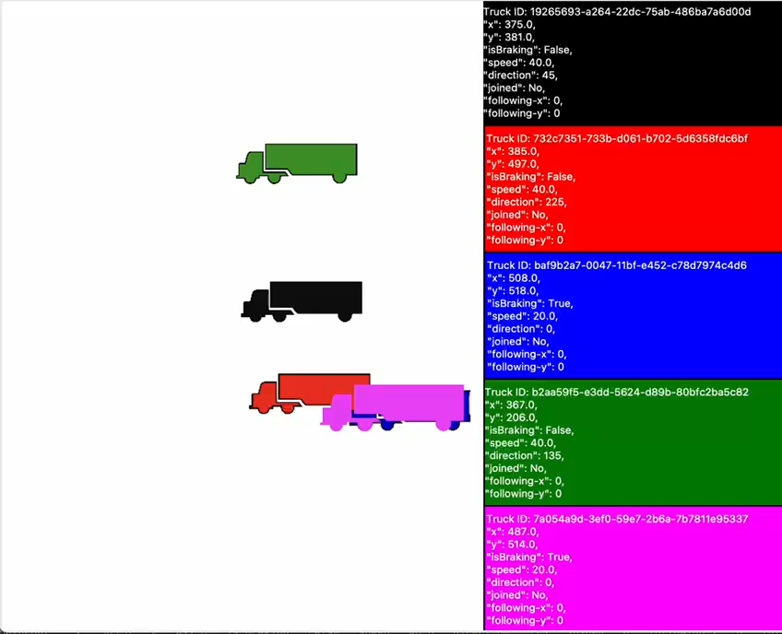
Simulation (Python)
Trucks are joining the platoon one by one
joined variable changes to “Yes” when the truck joins a platoon
Finally all the trucks are in the platoon

Slide 21

The End

